Slide 1

Introduction to SaltStack

Slide 2
WHAT IS SALT?
Python based, remote execution tool and configuration management system, created and developed by Thomas S Hatch.
Salt is a different approach to infrastructure management, founded on the idea that high-speed communication with large numbers of systems can open up new capabilities. This approach makes Salt a powerful multitasking system that can solve many specific problems in an infrastructure.
The backbone of Salt is the remote execution engine, which creates a high-speed, secure and bi-directional communication net for groups of systems. On top of this communication system, Salt provides an extremely fast, flexible, and easy-to-use configuration management system called Salt States.

Slide 3
Supporting the "Infrastructure as Code" approach to deployment and cloud management, it competes primarily with Puppet, Chef, and Ansible.
The remote execution: run commands on various machines in parallel with a flexible targeting system.
The configuration management: establishes a client-server model to quickly, easily and securely bring infrastructure components inline with a given policy.

Slide 4
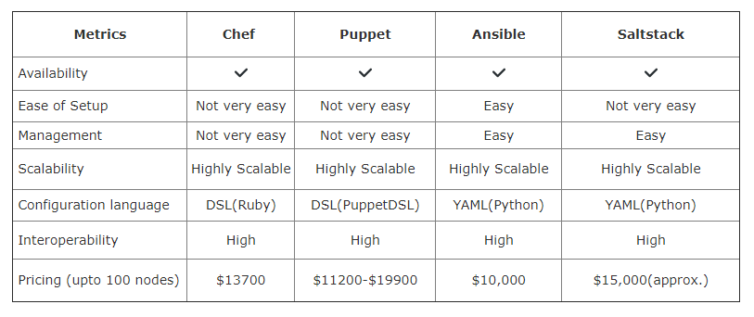
Comparison

Slide 5
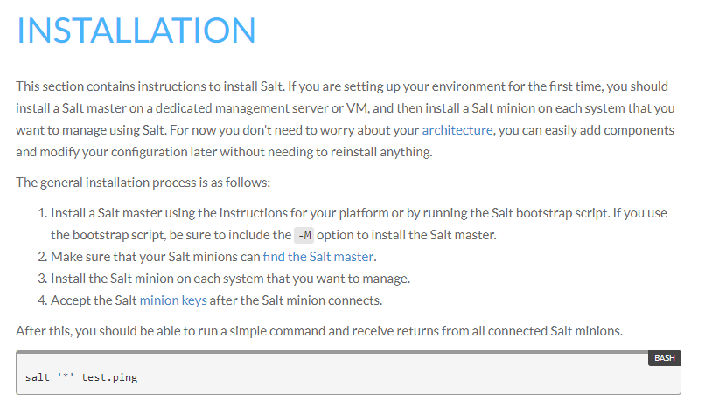

Slide 6
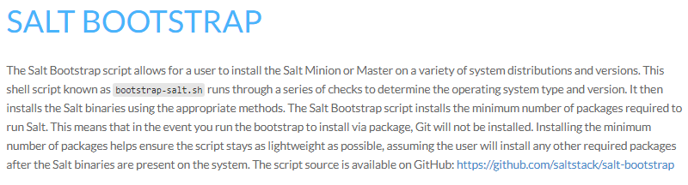

Slide 7
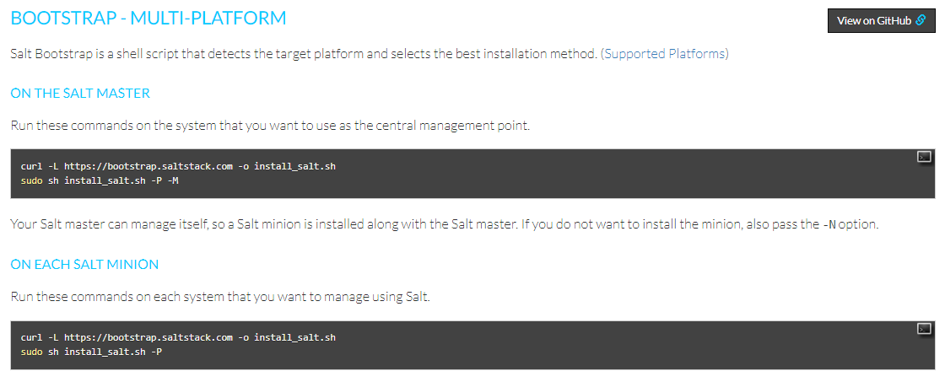

Slide 8

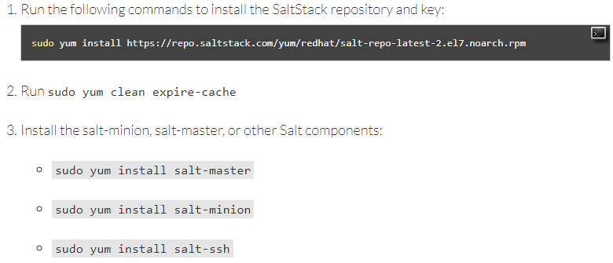
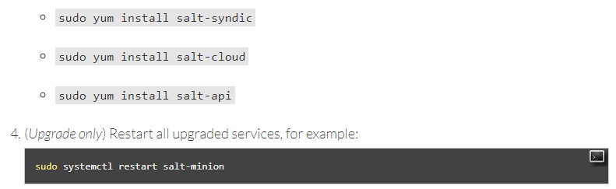

Slide 9
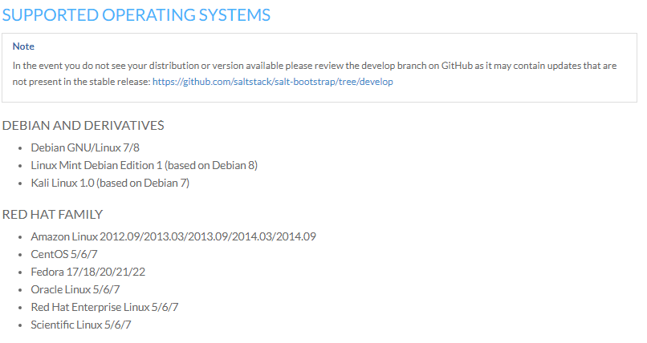

Slide 10
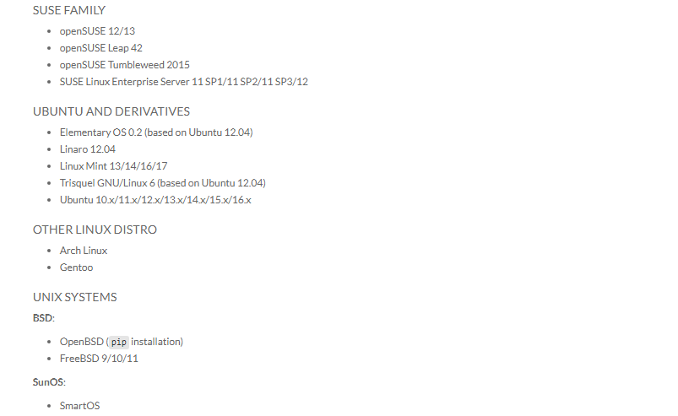

Slide 11
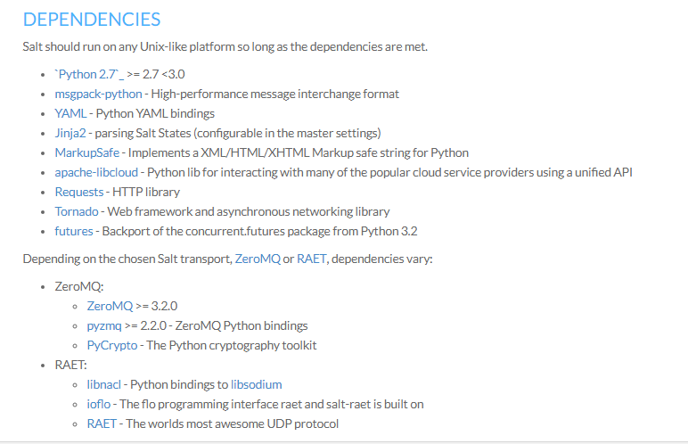

Slide 12
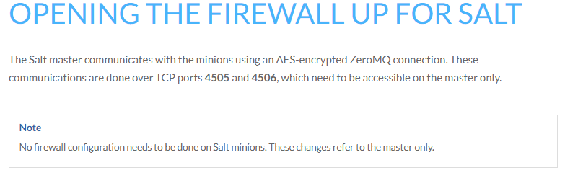
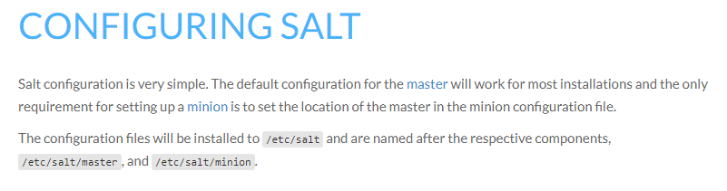

Slide 13
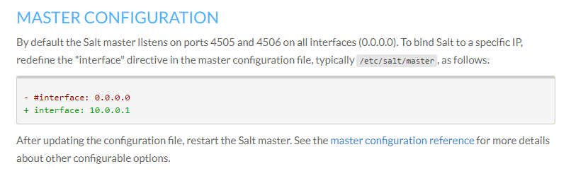

Slide 14
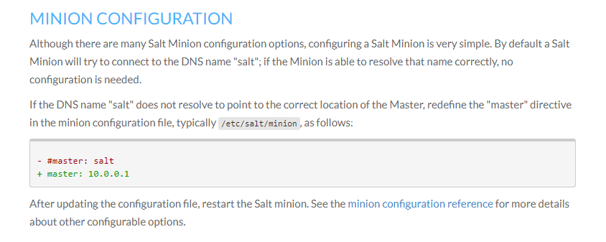

Slide 15
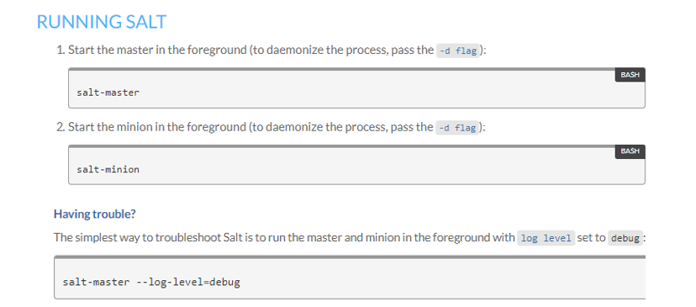

Slide 16
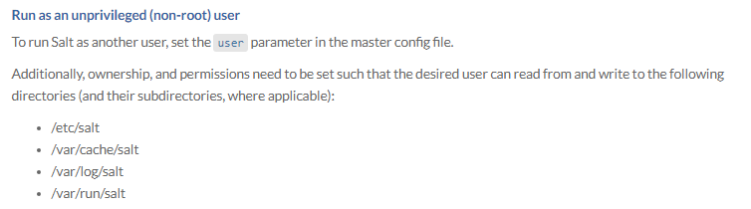

Slide 17
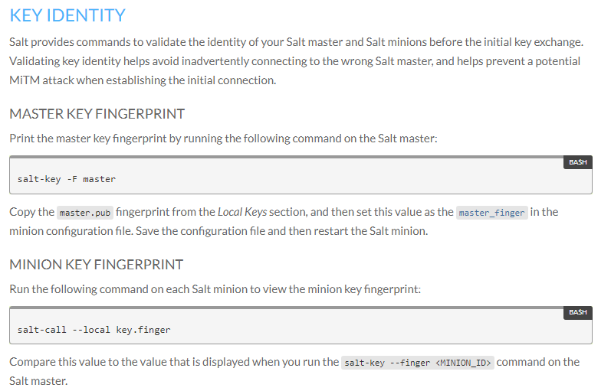

Slide 18
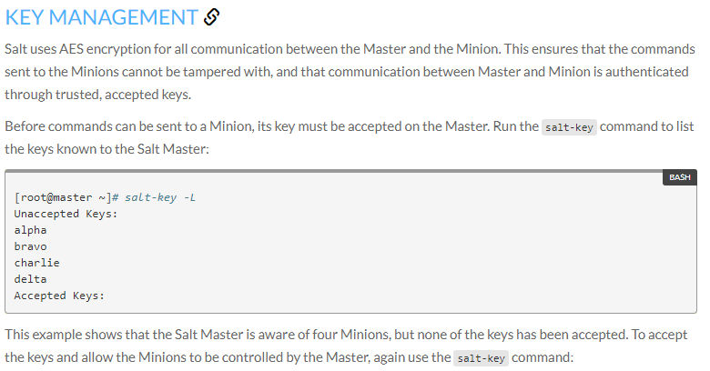

Slide 19
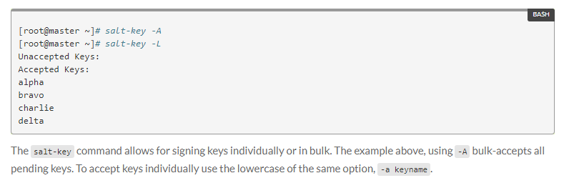
KEY MANAGEMENT

Slide 20
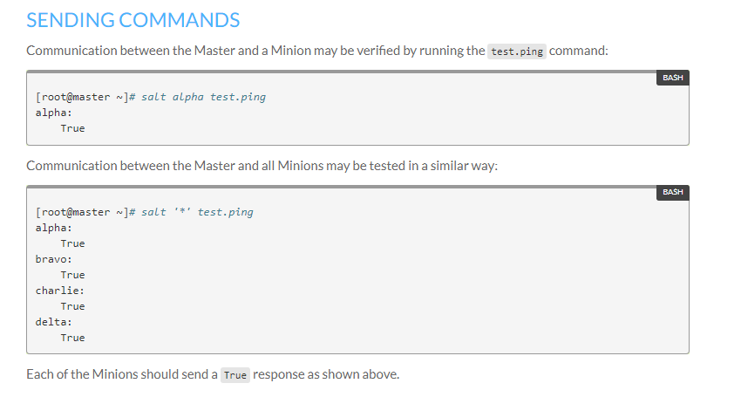

Slide 21
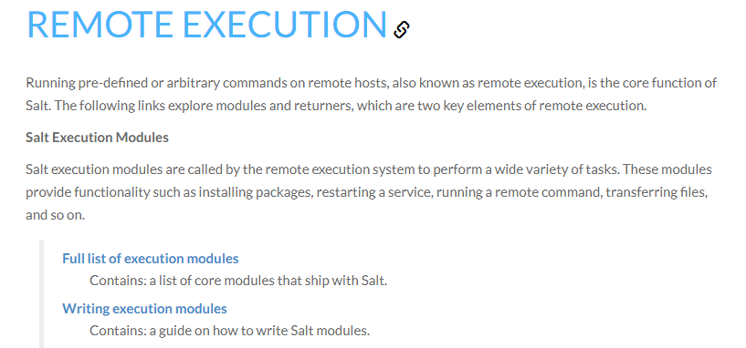

Slide 22
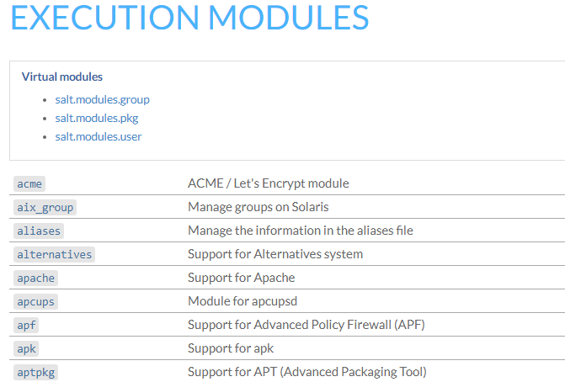

Slide 23
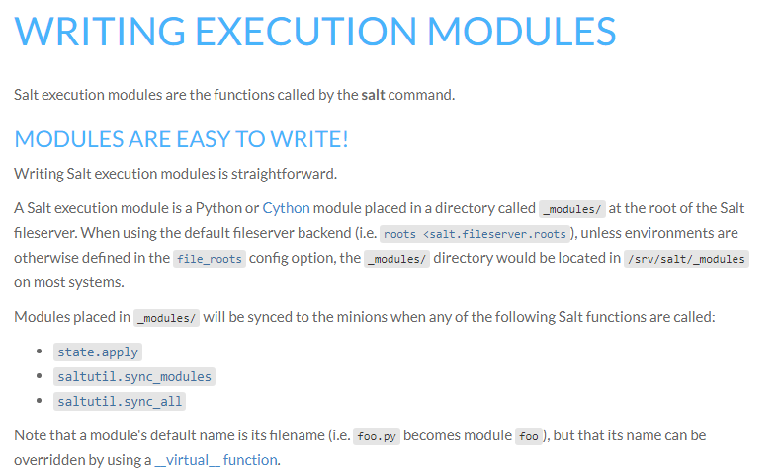

Slide 24
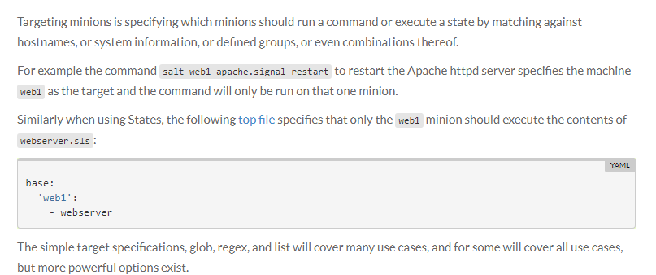
TARGETING MINIONS

Slide 25
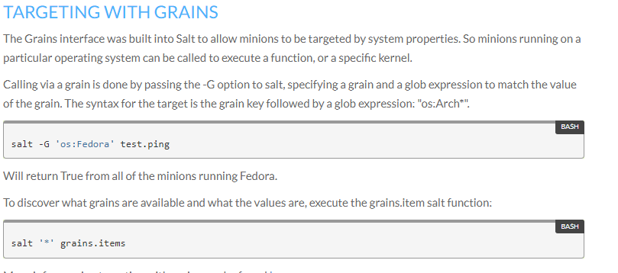

Slide 26
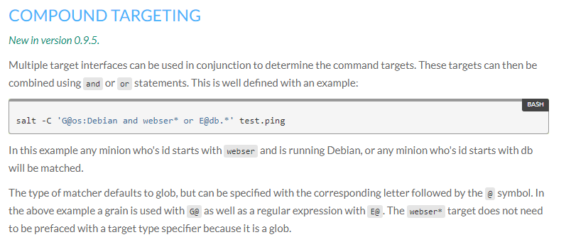

Slide 27
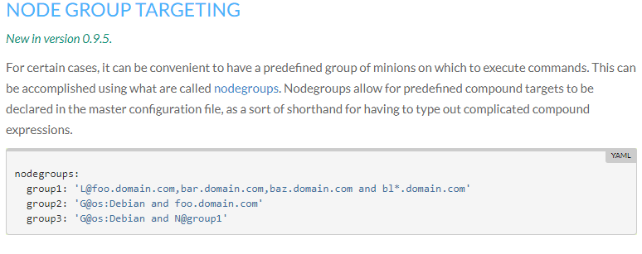

Slide 28
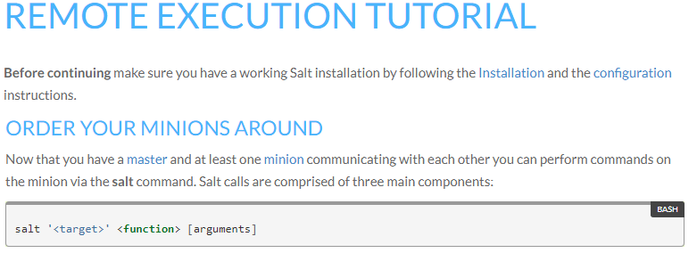
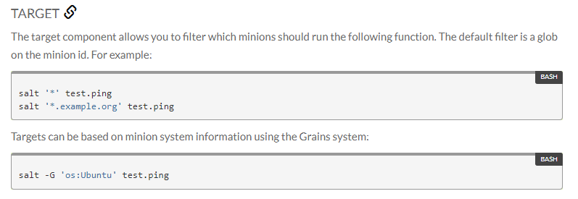

Slide 29
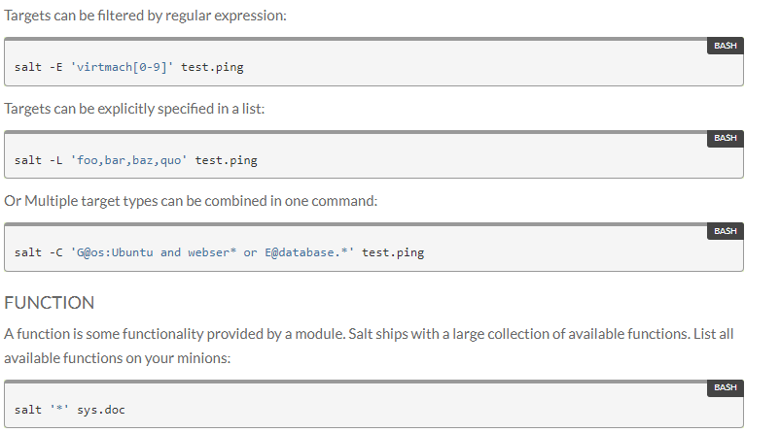

Slide 30
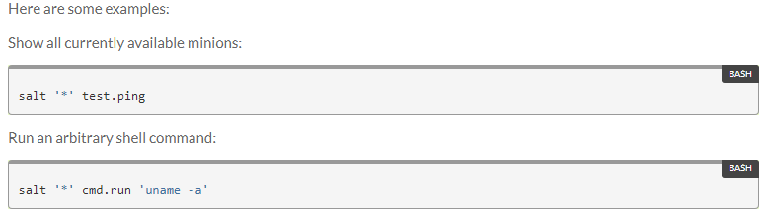
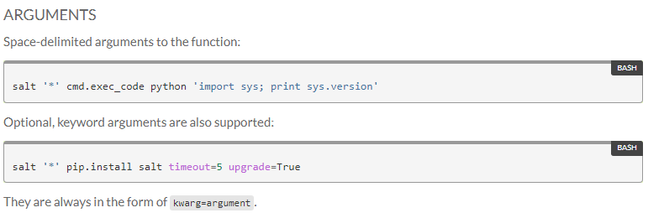

Slide 31
References :-
https://docs.saltstack.com/en/latest/topics/tutorials/states_pt1.html
https://docs.saltstack.com/en/latest/topics/installation/index.html#installation
https://docs.saltstack.com/en/latest/ref/configuration/index.html#configuring-salt
https://docs.saltstack.com/en/latest/topics/tutorials/walkthrough.html

Slide 32
Thank You!!

